Slide 1
Running vest design log
Mr Graham

Slide 2
Requirements
only use elements from primary sources
include a design on both front and back
include your logo and the text 'On your marks!'
include at least one other visual link to the gift bag
appeal to your target audience

Slide 3
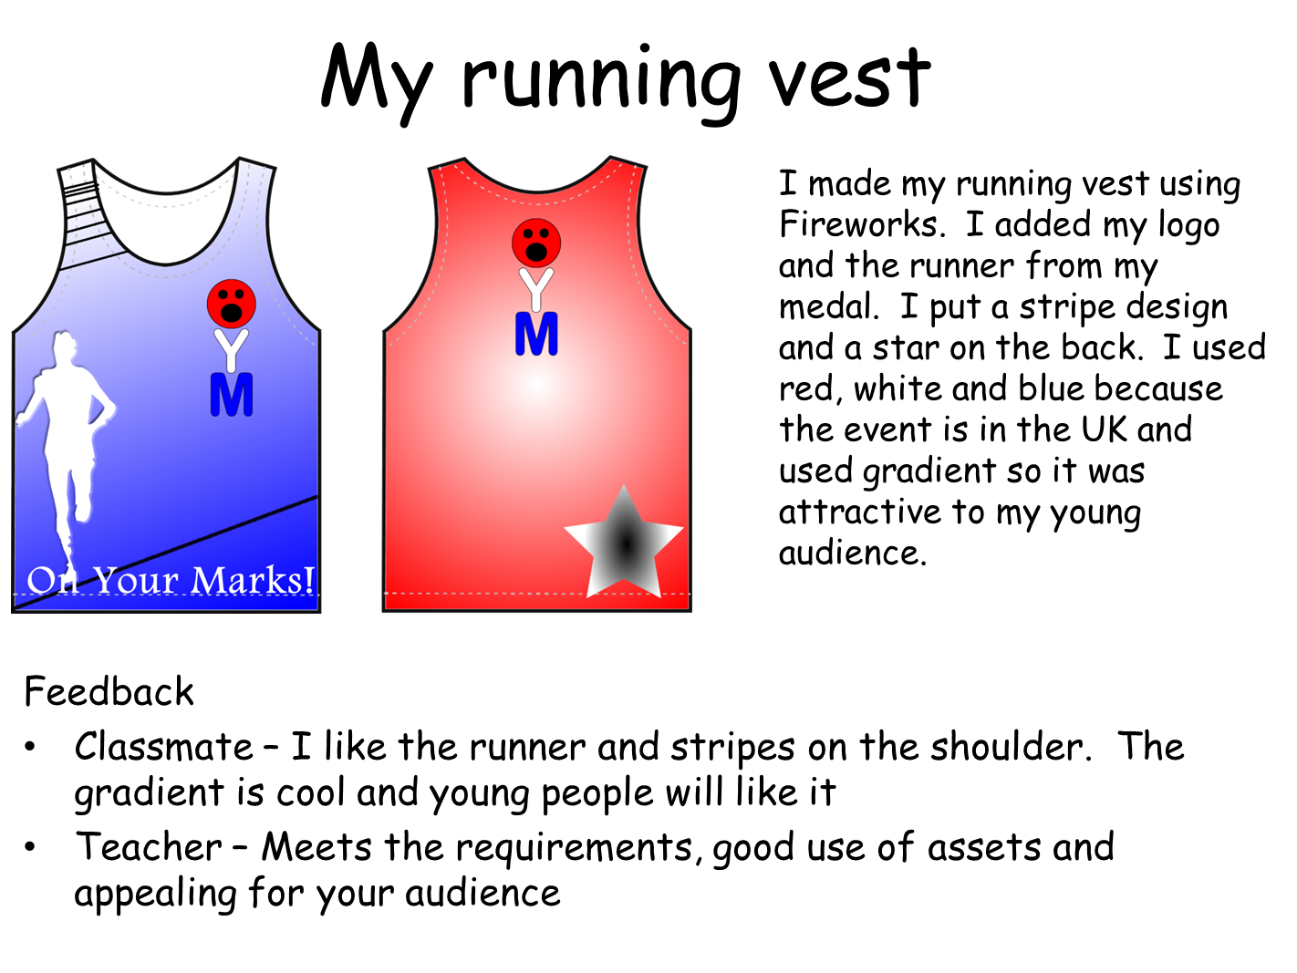

Slide 4
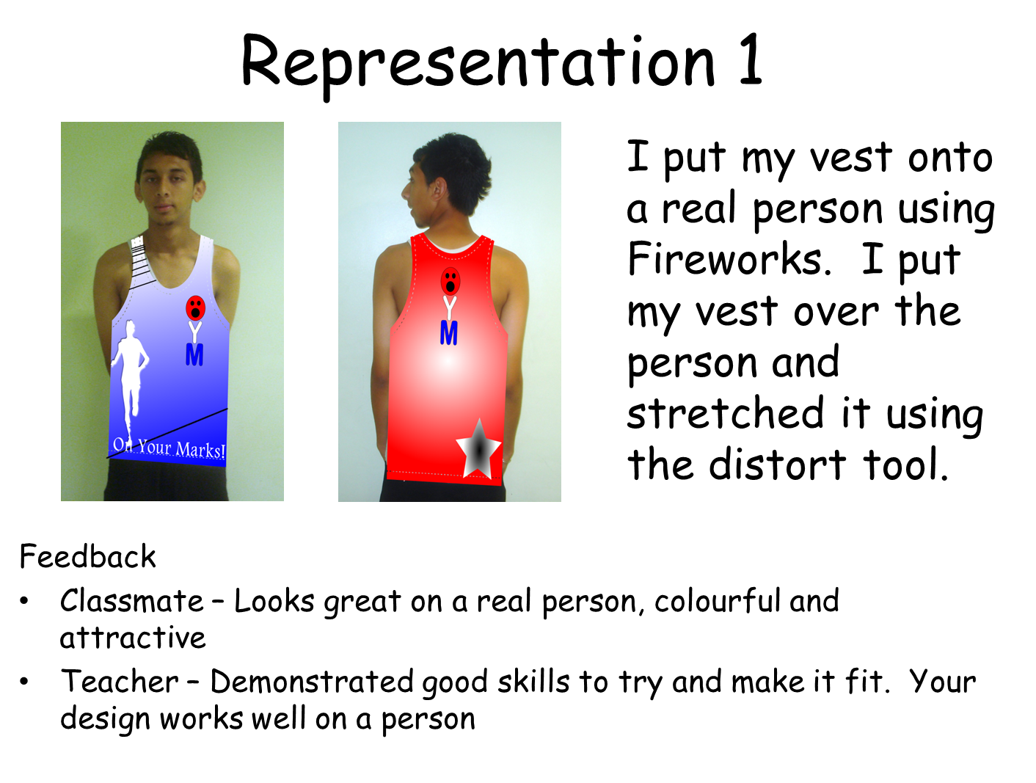

Slide 5
